Slide 1





HomeMedi
HomeMedi
A startup online hospital

Slide 2




HomeMedi
Progress
Members
Introduction
Problem Statement
Target Audience
Company Structure
Detailed Plan
Revenue Plan
KPIs to Measure User Engagement

Slide 3






OUR TEAM MEMBERS
GROUP 09
HomeMedi
Ly Nhat Hao
Nguyen Duy Dang Khoa
CEO
lnhao21@clc.fitus.edu.vn
CTO
nddkhoa21@clc.fitus.edu.vn
Nguyen Nhat Quan
Tu Phuoc Toan
Finance Department Head
20127066@student.hcmus.edu.vn
Marketing Department Head
tptoan21@clc.fitus.edu.vn

Slide 4
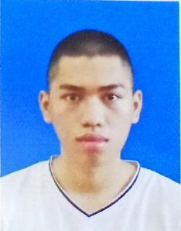


OUR TEAM MEMBERS
GROUP 09
HomeMedi
Phan Phuoc Hai Nam
Phan Tri Tai
Data Engineer
pphnam21@clc.fitus.edu.vn
Software Engineering
pttai20@clc.fitus.edu.vn
Tran Minh Khoa
Hr Department Head
tmkhoa21@clc.fitus.edu.vn

Slide 5



HomeMedi
A medical consultation model dedicated to providing high-quality healthcare services to everyone, regardless of location, at an affordable cost
Introduction

Slide 6

HomeMedi
Problem Statement
Demand
Challenges
Solution
Services and Commitment
The demand for healthcare and medical consultations is increasingly prioritized
The overcrowding of traditional hospitals and medical facilities has made it more challenging to meet these needs
Online medical consultation model aims to provide high-quality healthcare services to everyone,
Integrating digital health tools and AI-driven diagnostic support, HomeMedi offers personalized healthcare services

Slide 7




HomeMedi
Vietnamese Citizens
HomeMedi is designed for everyone, provided they are Vietnamese citizens
Target Audience
Individuals with Internet-Enabled Mobile Devices
Users must have a mobile device capable of connecting to the Internet
People Needing Healthcare Services or Remote Medical Consultations:
Those who have a need for healthcare services or remote medical consultations.

Slide 8
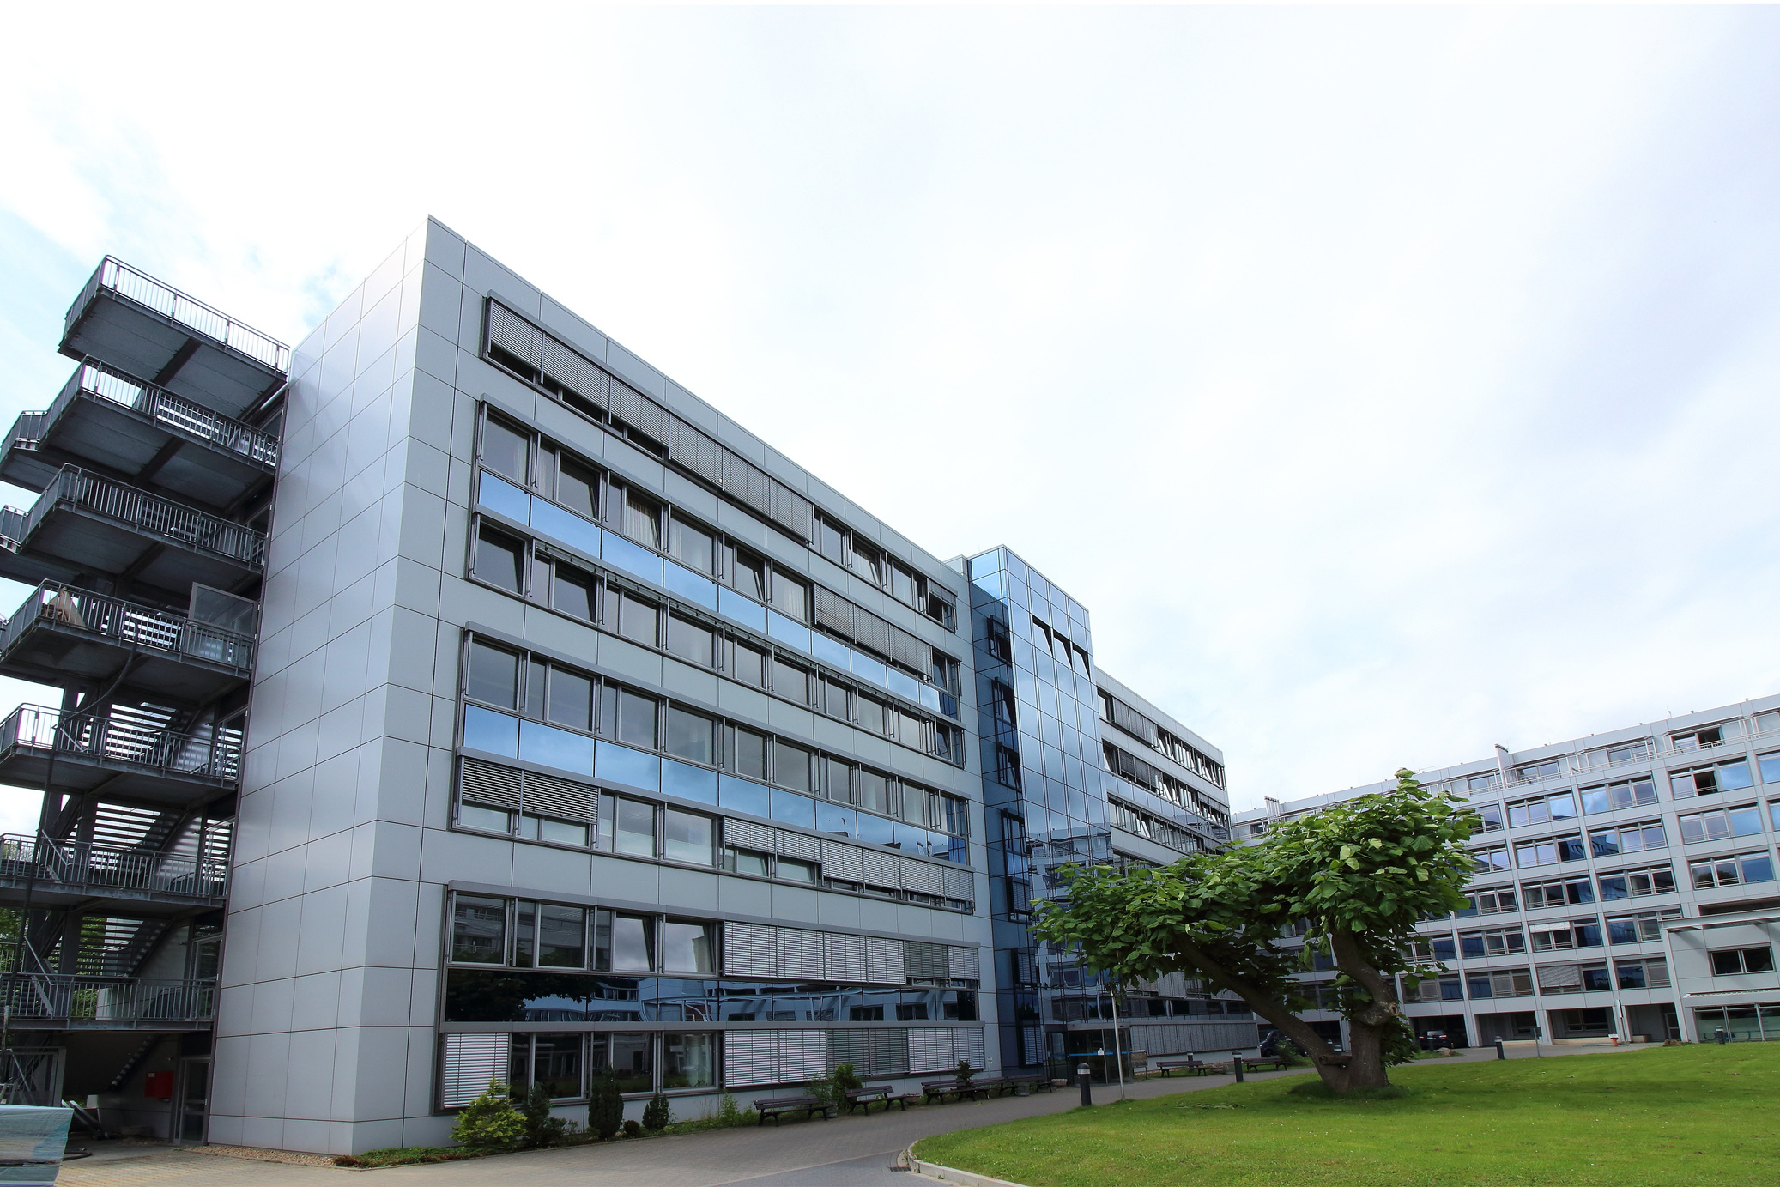
HomeMedi
Company Structure

Slide 9




HomeMedi
Overview
Type of Business: Limited Liability Company (LLC)
Headquarters: Ho Chi Minh City, Vietnam

Slide 10

HomeMedi
Departments
Product Development: Focus on developing and maintaining HomeMedi’s telemedicine platform
Marketing: Responsible for promoting HomeMedi’s services and reaching the target audience
Finance & Operations: Manages the company’s financial health and ensures smooth operational processes

Slide 11
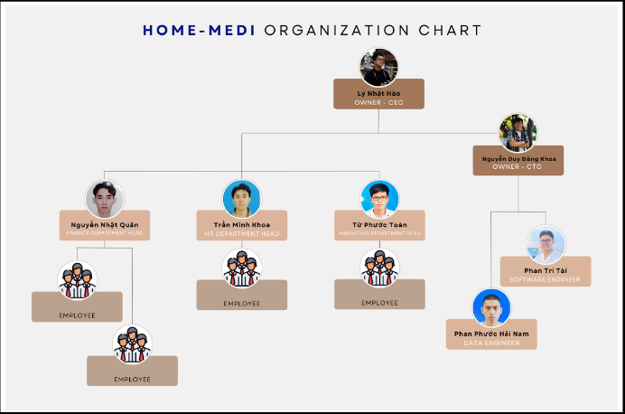
Orginazation
HomeMedi

Slide 12

HomeMedi
Detailed Plan
Sprint 1 | Sprint 2 | Sprint 3 | Sprint 4
Project setup, Database design, User login/register | Profile management, Search for doctors | Doctor profiles, Appointment scheduling | Video call, Chat system
Sprint 5 | Sprint 6 | Sprint 7 | Sprint 8
Self-diagnosis from symptoms, Medical history tracking | Payment methods, Billing history | Notifications, Feedback system | System performance optimization, Security audit, Bug fixes

Slide 13

HomeMedi
Revenue Plan

Slide 14
HomeMedi
General Practitioner
Fee structure
Specialist
Consultation Fees
Commission Structure
10% of sale
Corporate Packages
Corporate Partnerships
Partnerships with Pharmacies
Revenue Plan
Banner Ads
Basic Plan
Subscription Plans
Advertising and Promotions
Advertising Rates
Medication Delivery Fees
Premium Plan
Sponsored Content
Standard Delivery
Delivery Fee Structure
Express Delivery

Slide 15



HomeMedi
KPIs to Measure User Engagement

Slide 16

HomeMedi
User Acquisition Metrics
Consultation Metrics
User Retention and Satisfaction
Number of Registered Users
Number of Consultations
User Retention Rate
Monthly Active Users (MAU)
Consultation Completion Rate
Customer Satisfaction Score (CSAT)
Net Promoter Score (NPS)

Slide 17
HomeMedi
Revenue Metrics
Engagement and Usage Metrics
Operational Efficiency
Monthly Recurring Revenue (MRR)
Average Session Duration
First Response Time
Average Revenue Per User (ARPU)
Feature Usage Rate
Resolution Time

Slide 18

HomeMedi
Thank you!

